Slide 1


Have you ever wanted
TO LEARN
how to prepare
those
Delicious Recipes?

Slide 2






Have you ever tried
Preparing One

Slide 3
Have you ever tried
doesn't come out RIGHT
and it
just
Preparing One

Slide 4

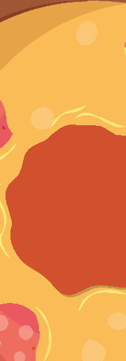



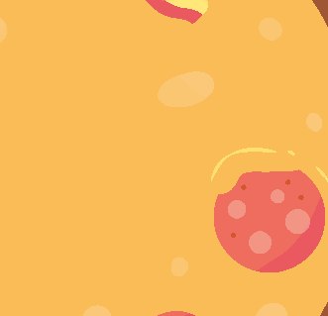



OR do you want
to ensure you are
BEST RECIPE
MAKING
delicious meals right
the first time?

Slide 5
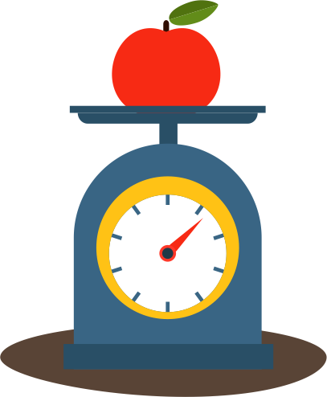

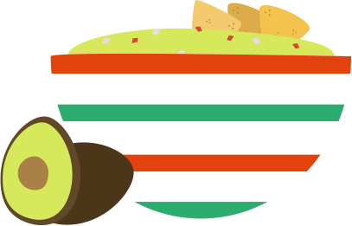




Our recipes are
not only delicious
BUT ALSO
VERY nutritious and
revitalizing for the body.

Slide 6


However
making these meals
the wrong way
may not only taste unpleasant

Slide 7

you may
end
up reducing
the effectiveness
of the
meal as well.

Slide 8

This
recipe e-book
is loaded
with dozens of healthy
recipes in addition
to having a meal plan

Slide 9
that gives you great
to coordinate
ideas on
how
your meals for
THE BEST RESULT
possible with
improving your health
50%
80%
65%
40%

Slide 10
Written by an expert
with years of experience and having
the compassion to help those struggling
Be A Chef

Slide 11
This e-book
contains nothing but
the best healthy recipes
Your body deserves the very best

Slide 12
Therefore get instant access now
and start living a healthier lifestyle
DOWNLOAD NOW
you can find on
The Paleo way

